Slide 1
DIABETES PREDICTION SYSTEM
Presented by..
J Rajesh

Slide 2
ABSTRACT
Diabetes is a chronic disease affecting millions worldwide, with early detection being crucial to preventing severe complications. Traditional diagnostic methods, while effective, are often invasive, time-consuming, and lack predictive capabilities. To address this, our project focuses on leveraging machine learning techniques to develop a robust diabetes prediction model. By analyzing significant health parameters such as glucose levels, BMI, and age, our model aims to provide accurate predictions and assist in early intervention strategies. This approach not only improves diagnostic efficiency but also highlights the potential of technology-driven solutions in transforming healthcare outcomes.

Slide 3
EXISTING METHOD
Traditional diagnosis methods for diabetes include blood tests and medical history. However, these methods have limitations, such as high cost and invasiveness. Existing machine learning approaches, such as logistic regression and decision trees, have been used for diabetes prediction, but they have limitations in terms of accuracy and interpretability.
Disadvantages:
Low accuracy and precision
Difficulty handling high-dimensional data
Prone to overfitting and underfitting
Limited interpretability of results

Slide 4
PROPOSED METHOD
Our proposed method uses a random forest classifier to predict diabetes. The random forest algorithm is an ensemble learning method that combines multiple decision trees to improve the accuracy and robustness of the model. Our model uses a dataset of patient characteristics, including age, insulin, body mass index (BMI), and blood pressure, skin thickness etc.
Advantages:
High accuracy and precision (82% accuracy)
Ability to handle high-dimensional data and complex relationships
Robustness to outliers and missing values

Slide 5
HARDWARE & SOFTWARE REQUIREMENTS
H/W Configuration:
• Processor - I3/Intel Processor
• Hard Disk -160GB
• RAM - 8Gb
S/W Configuration:
• Operating System : Windows 11 .
• IDE : Pycharm.
• Libraries Used : Pandas –v2.2.2, Sk-learn -1.5.0, Django –v5.0.6
• Technology : Python 3.12.

Slide 6
Methodolgy
Data Collection: The dataset used in this project is the Pima Indians Diabetes Database, which contains 768 patient records.Data
Preprocessing: The dataset was preprocessed by handling missing values and normalizing the data.
Feature Selection: Relevant attributes for diabetes prediction were selected using correlation analysis.
Model Evaluation: The model was evaluated using accuracy, precision, recall, and F1-score metrics.

Slide 7
ALGORITHMS
Logistic Regression
Logistic Regression is a supervised learning algorithm that models the probability of a binary outcome using a logistic function. It is a simple and interpretable algorithm that is effective for binary classification tasks. Logistic Regression is widely used in credit risk assessment, medical diagnosis, and customer churn prediction.
2. Decision Tree:
Decision Trees is a supervised learning algorithm that recursively partitions data into subsets based on feature values. It is an interpretable algorithm that is effective for classification and regression tasks. Decision Trees is widely used in customer segmentation, risk analysis, and recommendation systems.

Slide 8
3. Random Forest :
Random Forest is a supervised learning algorithm that combines multiple decision trees to improve accuracy and robustness. It handles high-dimensional data and is robust to outliers. Random Forest is widely used in classification, regression, and feature selection tasks.
4. Support Vector Machine (SVM):
Support Vector Machine (SVM) is a supervised learning algorithm that finds the best hyperplane to separate classes in feature space. It is effective in high-dimensional spaces and can handle non-linear relationships. SVM is robust and efficient, making it a popular choice for classification and regression tasks. It is widely used in image classification, text classification, and bioinformatics.

Slide 9
5. K-Nearest Neighbors (KNN):
K-Nearest Neighbors (KNN) is a supervised learning algorithm that predicts the target variable by finding the k most similar instances to the new input. It is a simple and intuitive algorithm that is effective for small datasets. KNN is widely used in recommendation systems, image recognition, and natural language processing.
6. Gradient Boosting
Gradient Boosting is a supervised learning algorithm that combines multiple weak models to create a strong predictive model. It handles high-dimensional data and is robust to outliers. Gradient Boosting is widely used in regression, classification, and ranking tasks.

Slide 10
IMPLEMENTATION
first we have taken Diabetes prediction extended data .
load the dataset into work environment and made a check for null values if any.
after checking the null values split the data in to train data and test data.
after splitting apply the algorithm and fit the train data and test data.
we got the best Accuracy of Random forest.
later, the entire work is done with django framework
user can view the welcome, prediction.
after detection, we will get to know the prediction of Diabetes prediction system whether the result is positive or negative.

Slide 11
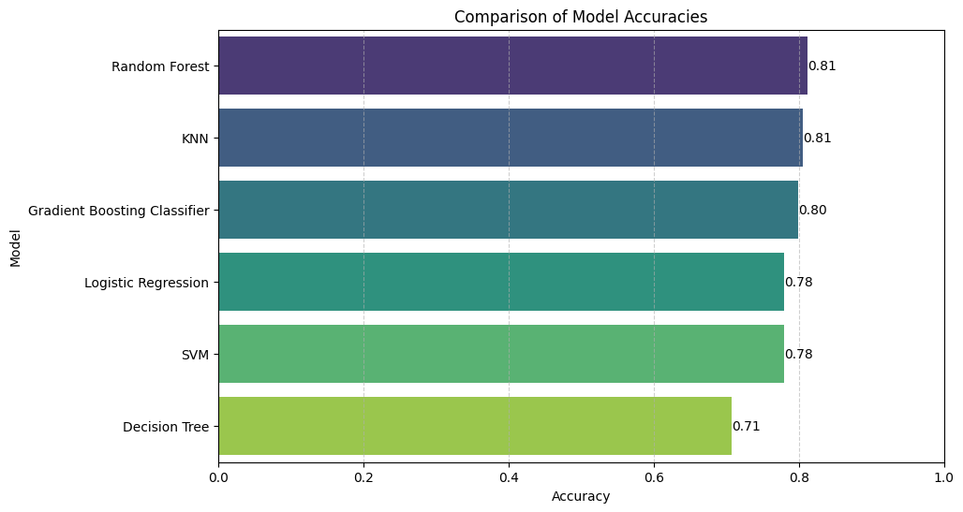
Compared Accuracy

Slide 12
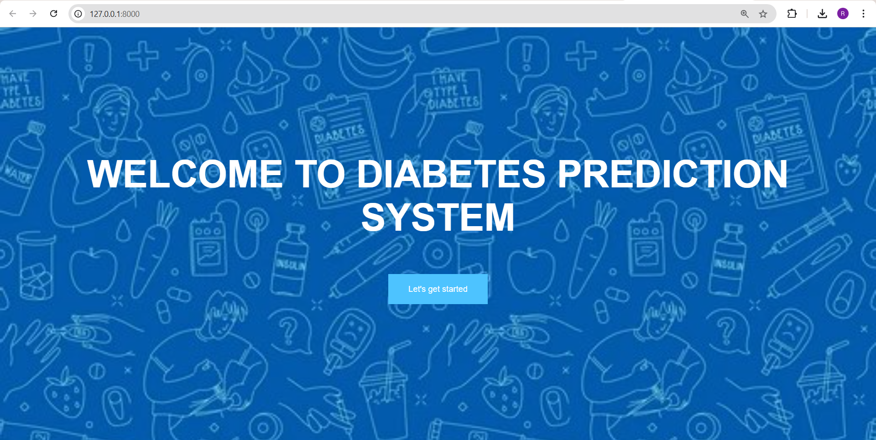
OUTPUT SCREEN SHOTS WITH DESCRIPTION
Home Page: Home page of the project

Slide 13
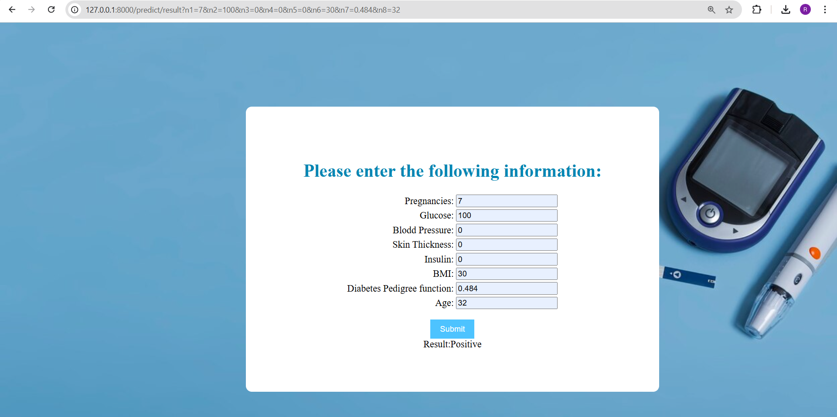
Prediction Page :

Slide 14
CONCLUSION
In conclusion, our proposed random forest model achieves high accuracy and outperforms other machine learning algorithms for diabetes prediction. The model can be used as a tool for early diabetes detection and can help improve patient outcomes. Future directions include collecting more data and exploring other machine learning algorithms to further improve the accuracy and robustness of the model.

Slide 15
THANK YOU

